Slide 1
Custom Health Equity Innovation Summit Overview

Slide 2
Agenda
Introduction (All)
Overview of state-level innovation summits (AHA Team)
  Description
  Sample agenda
  Health Equity Roadmap overview
  Design-thinking facilitation process
  Pricing models
  Example of One-Page Summary
  Example of Solutions Brief
Request Details (All)
Notes:
Overview of state-level innovation summits (AHA Team)
Description – Sonia Malik
Sample agenda – Riley Anderson
Health Equity Roadmap overview – Julie Kim
Design-thinking facilitation process – Julie Kim
Pricing models – Sonia Malik
Example of One-Page Summary – Julie Kim
Example of Solutions Brief – Julie Kim

Slide 3
What are Innovation Summits?
In 2023, AHA’s Institute for Diversity and Health Equity (IFDHE) traveled across the nation to host regional Health Equity Summits. IFDHE is now rolling out a format that is suitable for the state-level.
Summits are a one-day, interactive innovation workshop to co-design solutions for health equity within attendees’ organizations and regions.
Using the AHA’s Health Equity Roadmap as a framework, attendees are guided through an innovation design thinking session to tackle pertinent challenges in health equity, resulting in the creation of transformative health equity strategies.

Slide 4
Sample Agenda
Time | Action
9:30 am | Registration and Continental Breakfast
10:00 am | Welcome and Opening Comments
10:30 am | Fireside Chat
11:15 am | Break
11:30 am – 1:00 pm | Introduction to Health Equity Transformation Through Human-Centered Design Attendees will learn how to accelerate health equity transformation through various domains within health care organizational structures. We’ll introduce the AHA’s Equity Roadmap and organizational assessment tool and share various resources to support organizational change. Attendees will choose one of the available levers they would like to focus on. AHA staff will facilitate conversations for each present lever.
1:00 pm – 1:45 pm | Lunch
1:45 pm – 3:00 pm | Gallery Walk Discussion and Report-Out
3:00pm – 3:30 pm | Closing Comments, Next Steps, and Takeaways
3:30 pm | Adjourn

Slide 5
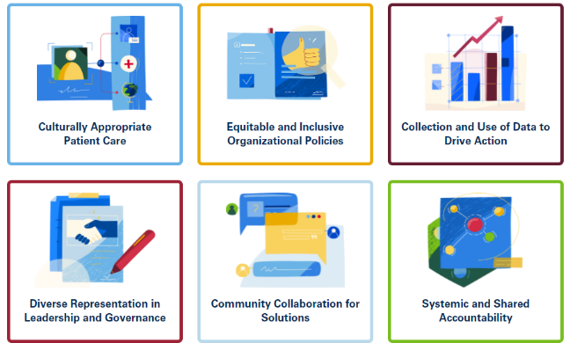

AHA Health Equity Roadmap
The Six Levers of Transformation
Research and experience show that leading health equity strategies cut across six levers of transformation within health care organizational structures.
The Health Equity Roadmap is a framework to help hospitals and health care systems chart their own paths toward transformation — thus becoming more equitable and inclusive organizations.

Slide 6
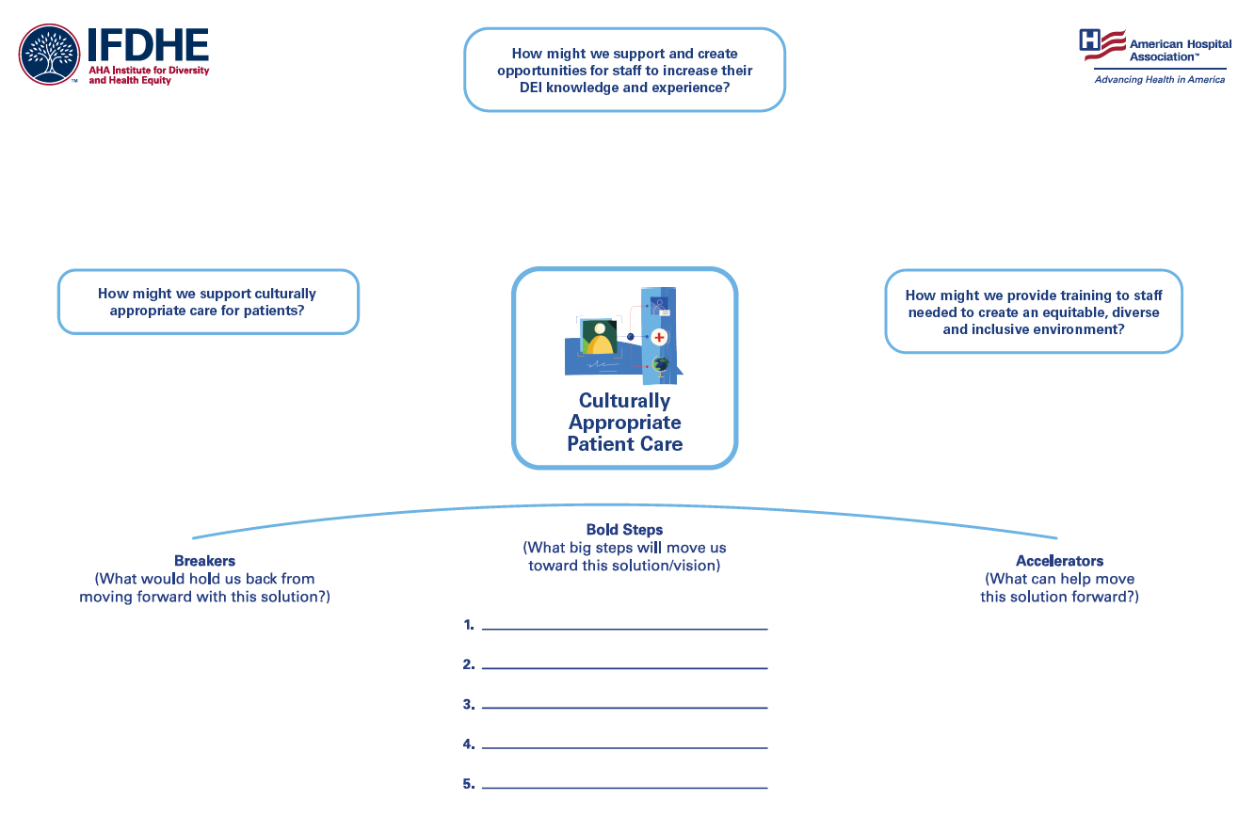
Design-Thinking Facilitation

Slide 7
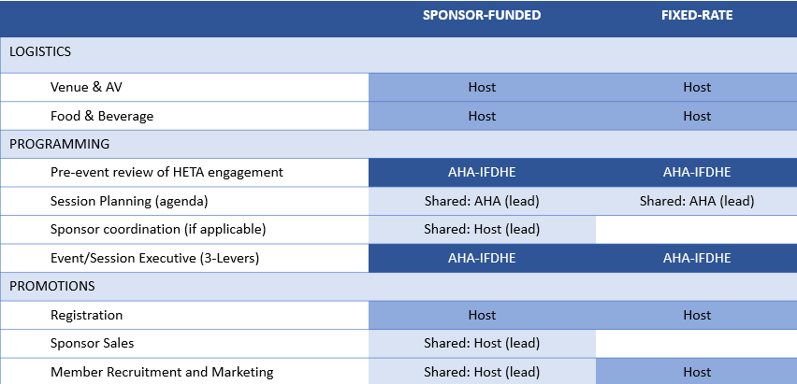
Payment Models
Base Price includes:
Facilitation of 3 tables (per lever)
Travel costs for 3 AHA facilitators
Printing/Shipping of facilitation meetings
Planning and programmatic design support
Meeting summary
Add-on options available:
Addition of facilitation tables (per lever)
In-depth Solutions Brief
Onsite AHA Communications Resource

Slide 8
Sample of a One-Page Write- Up

Slide 9
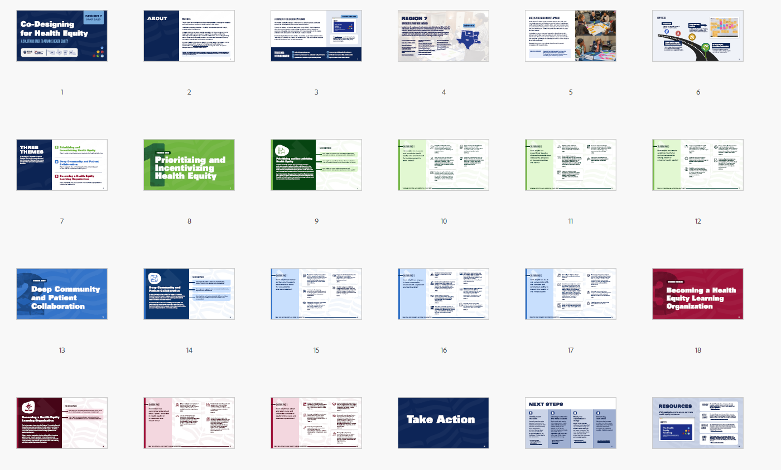
Sample of a Full Solution Brief

Slide 10
Closer Look at Full Solution Brief
Includes full analysis and identification of main themes from design-thinking session, addresses solution spaces within those themes, and provides specific examples taken directly from participant contributions.

Slide 11
Questions for Consideration
When and where would you like to have this summit?
  Would you like this summit to be a stand-alone or a part of another existing event?
How many attendees do you envision coming to this summit?
Which levers would you like to feature at this summit? How many tables per lever?
Which payment model are you interested in – partner (revenue share) or turnkey session?
Is there anything unique to your hospital association that you would like to be considered in programming?
When planning this event, who from your organization will be involved?
  Planning team
  Identifying panelists
  Identifying sponsors
  Logistics (before and during the event)

